Slide 1
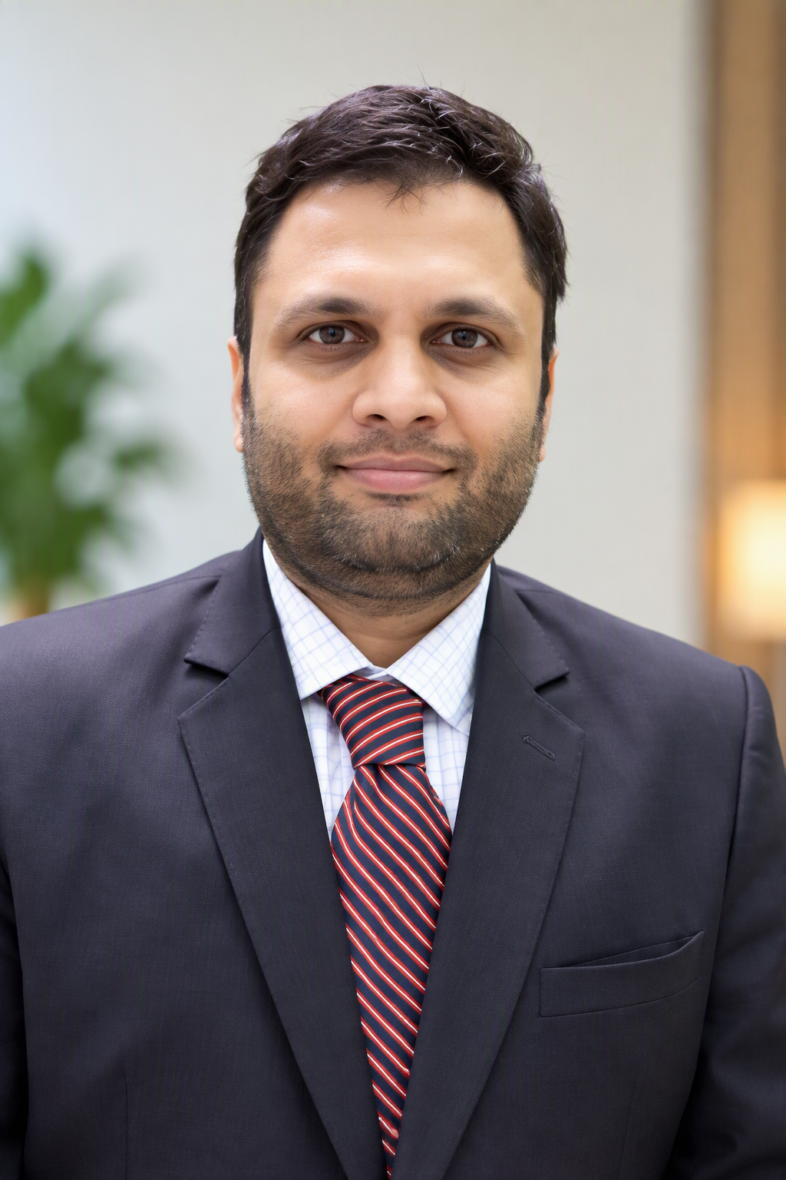
FCA, CISA Taher Pepermintwala - Partner
Helping regulated businesses prove control, manage cyber risk and get to the truth fast - blending audit judgement with forensics and automation.
Sector experience
Banks
NBFCs & HFCs
Payments & PPIs
Insurance
Core banking IS audits, fraud & NPA reviews, ITGC/ITAC
SBR compliance, RBIA, go-live readiness
Data localisation, SAR, payment security
IRDAI cyber reviews, red teaming, SOC
AMCs & AIFs
Healthcare
Logistics & Manufacturing
Tech, SaaS & BPO
Internal audit, PPM audits, certifications
Cyber insurance, BIA, DPDP readiness
Internal audit, Oracle migration testing, Management Reviews
SOC 1 / SOC 2, ISAE 3402, VA/PT
A
Assurance & Audit
C
Cybersecurity & IT Risk
Partner
IT Assurance, Cybersecurity & Digital Forensics
• Statutory and internal audits
• AIF / MF and PPM audits, certificates
• NBFC scale-based regulation reviews
• SOC 1 / SOC 2 (SSAE 21), ISAE 3402
• IS audits, ITGC, VA/PT, data migration
• RBI IT outsourcing and vendor audits
FCA, ICAI
CISA, ISACA-US
F
Digital Forensics
AI
Automation & Analytics
Dip IFRS, ACCA (UK)
Forensic Audit, NFSU
• Payment fraud and vigilance reviews
• Fund-diversion probes, asset tracing
• Email / device forensics, leak RCA
• CAAT analytics and audit dashboards
• AI reconciliations and faster close
• AI-assisted compliance review
JHS & Associates LLP
JHS Consulting Pvt Ltd | Mumbai
Frameworks
RBI Directions
DPDP Act
SEBI CSCRF
IRDAI
SSAE 21 / SOC
ISAE 3402
ISO 27001
GDPR
PCI-DSS

